Slide 1
Practice in Volkswagen OTLG

Slide 2
Volkswagen OTLG
450,000 m² of warehouse space
500,000 daily original parts
200,000 orders delivered within 24 hours
Volkswagen OTLG, is part of the Volkswagen Group and supply over 3,700 Volkswagen service companies, Volkswagen Commercial Vehicles, Audi, SEAT and ŠKODA in Germany and Denmark with original parts, accessories and services - all from a single source.

Slide 3
In the heart of Germany, in Baunatal near Kassel, headquarters is located in the factory of the second largest VW factory in Germany. Six distribution centers are located in the following locations:
Norderstedt (near Hamburg)
Ludwigsfelde (near Potsdam, Greater Berlin)
Baunatal (near Kassel)
Dieburg (Greater Frankfurt am Main)
Cologne Ludwigsburg (near Stuttgart)
Munich

Slide 5
The way of ordering in the company OTLG Volkswagen

Slide 6
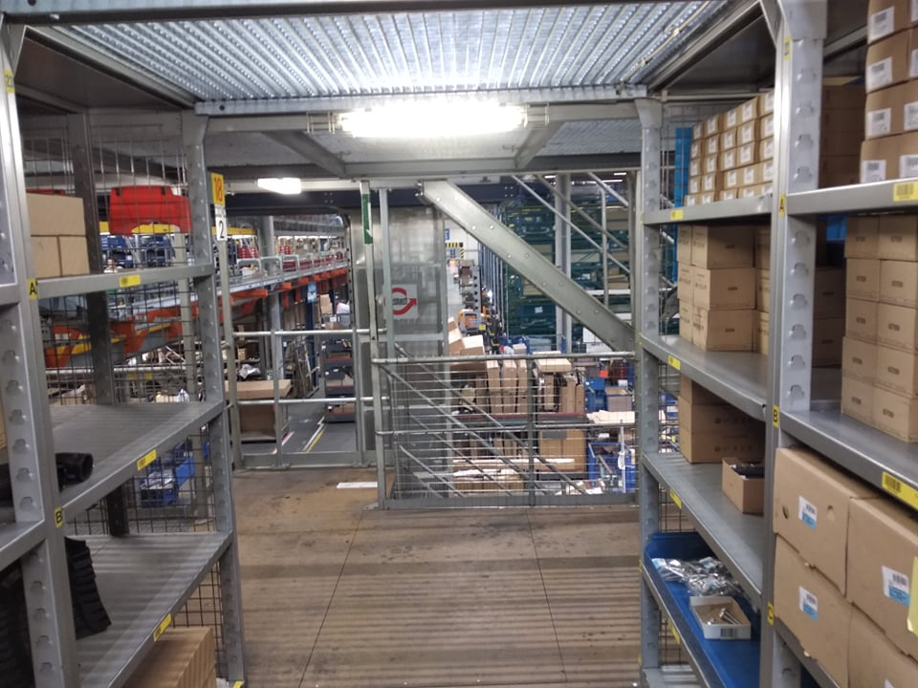
Our tasks for practice
We worked in a warehouse in zone 120 (Tomasz) and 230 (Marcin)

Slide 7
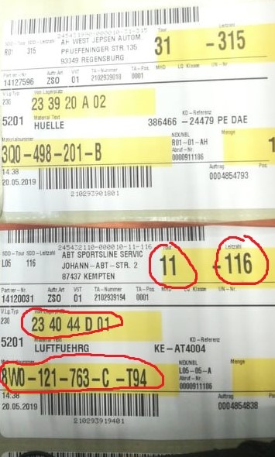
Our main task was to receive and ship the goods on the basis of printed labels

Slide 8
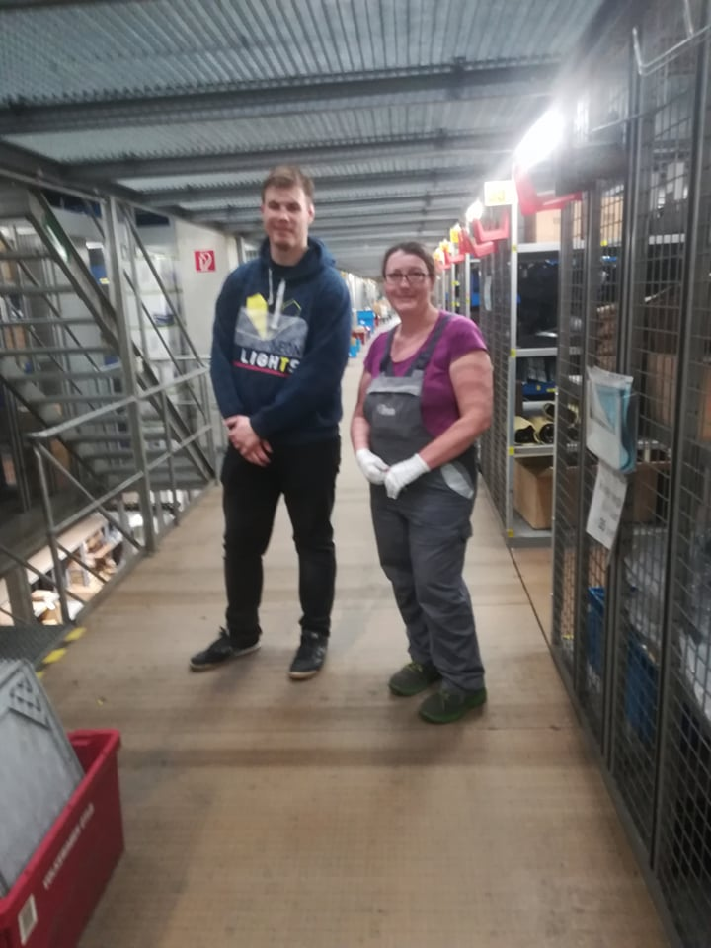
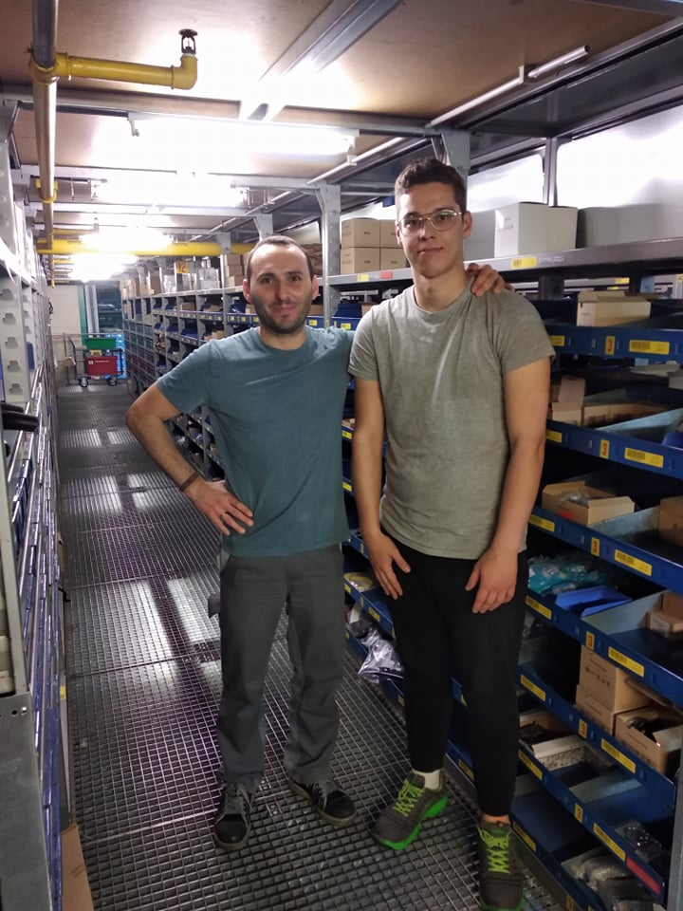

Slide 9
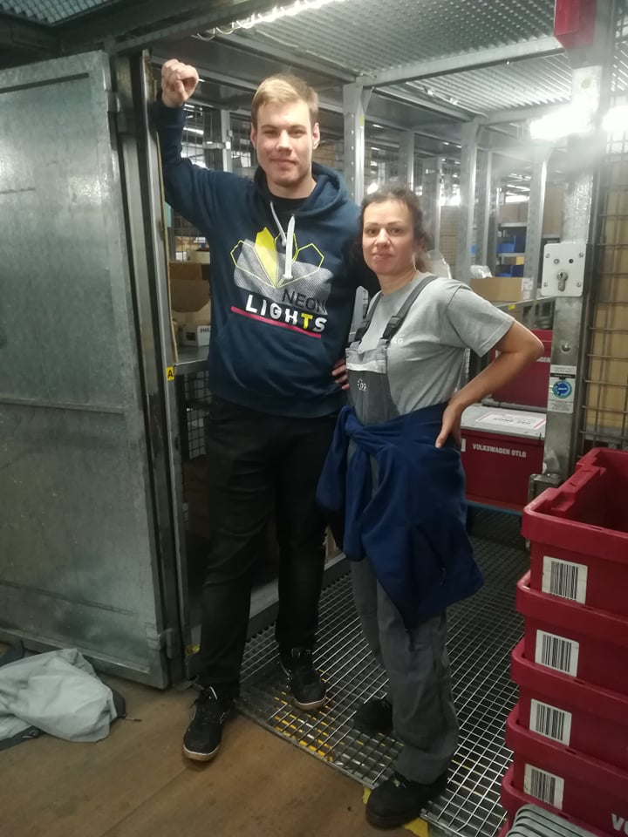
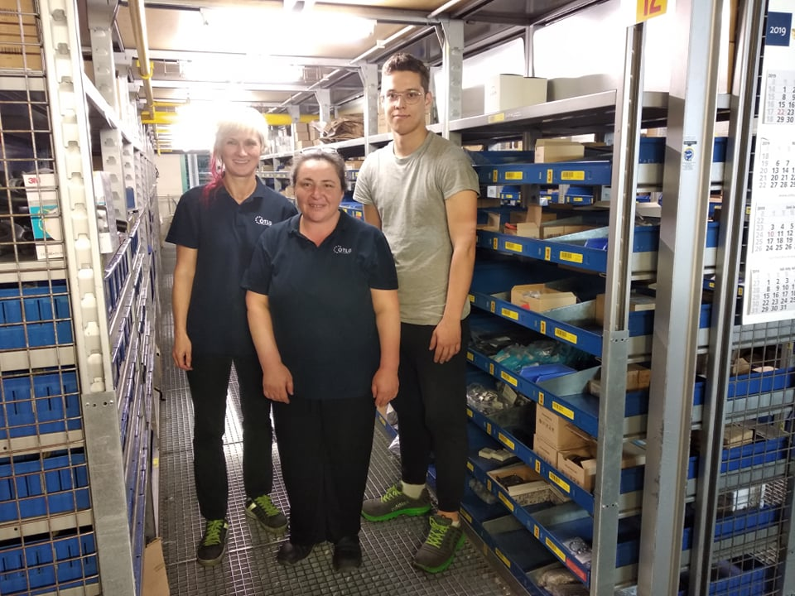

Slide 10
Thanks for your attention

